Slide 1
STUDY TIME

Slide 2
OVERVIEW OF THE PROJECT
Study Time helps to manage daily study time table better. It introduces the pomodoro technique which helps the students in improving focus, and concentrate better.

Slide 3
DESCRIPTION
Study Time is an application developed using ReactJS and Bootstrap where Pomodoro technique is implemented for efficient time management and it also has an additional feature of maintaining todo list. It mainly helps the students in better management of their time.

Slide 4
FEATURES
​ ​
→ Timer: Timer implements the pomodoro technique.
→ Add Todo: We can add necessary todo in our list using the Add Todo.​
→ My Todos: My Todos will display all the todos in our list.
→ About: It shows the implementation of pomodoro technique.

Slide 5
Technology used:
Software requirements:
→ Visual Studio code: Visual Studio Code, also commonly referred to as VS Code, is a source-code editor made by Microsoft with the Electron Framework, for Windows, Linux and macOS.
Hardware requirements:
→ Processor: Intel Core i5 and above
→ Memory: 8 GB

Slide 6
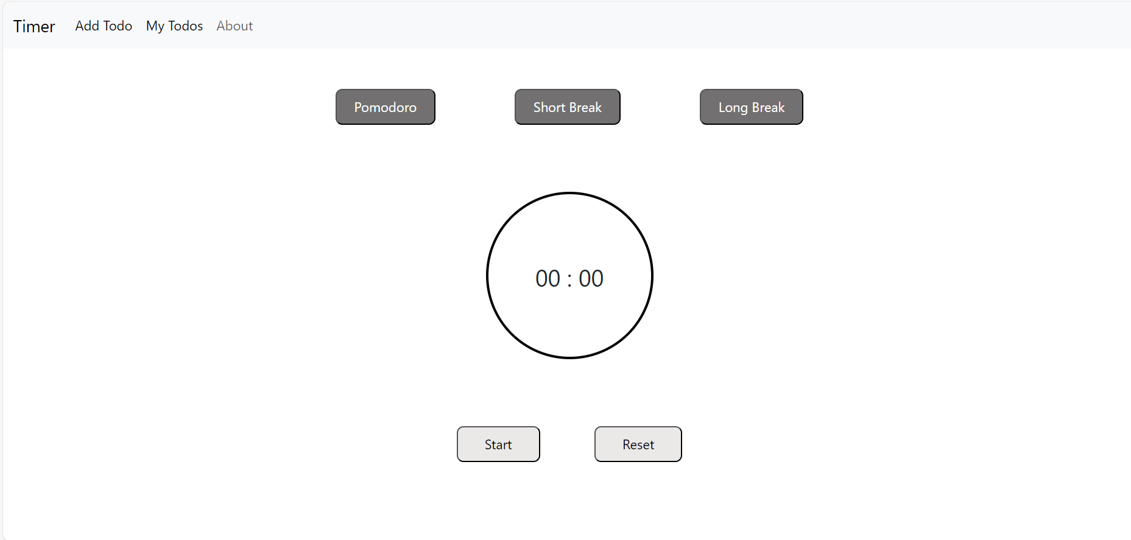
Initial Page

Slide 7
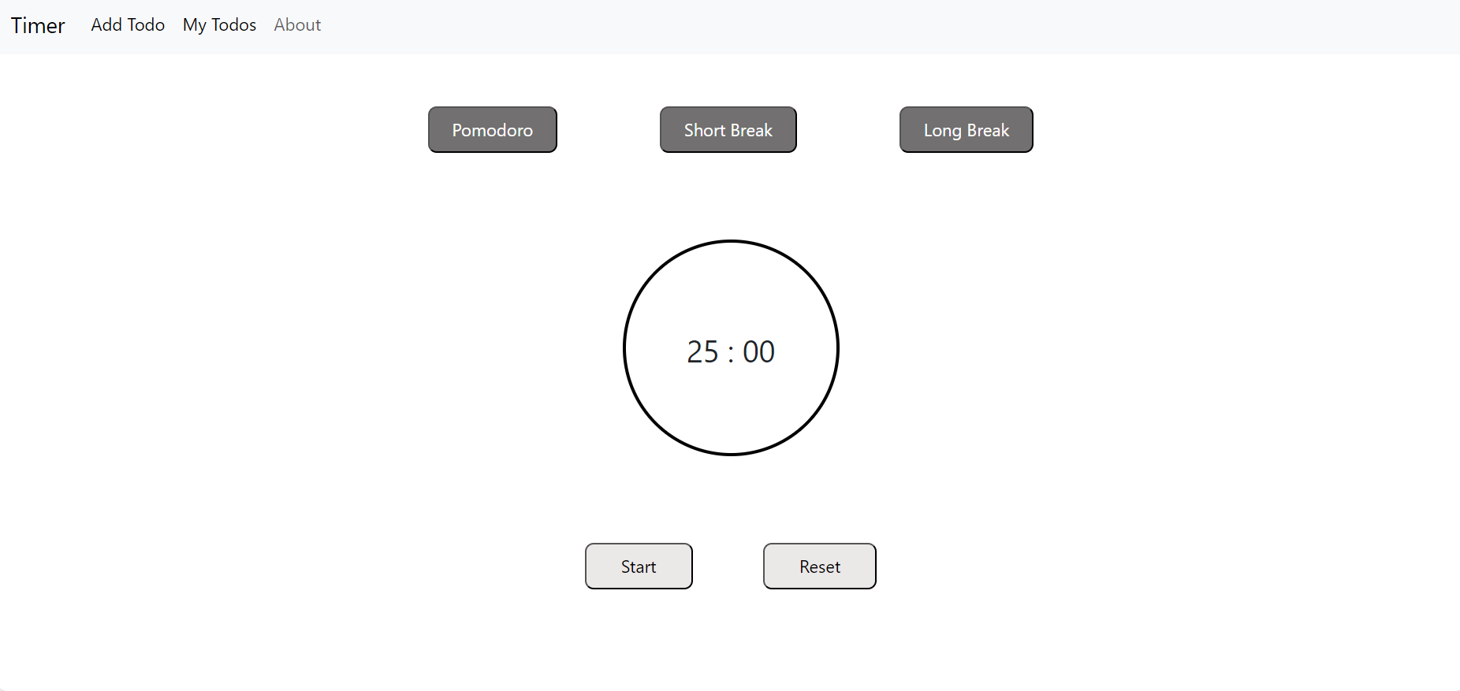
Pomodoro

Slide 8
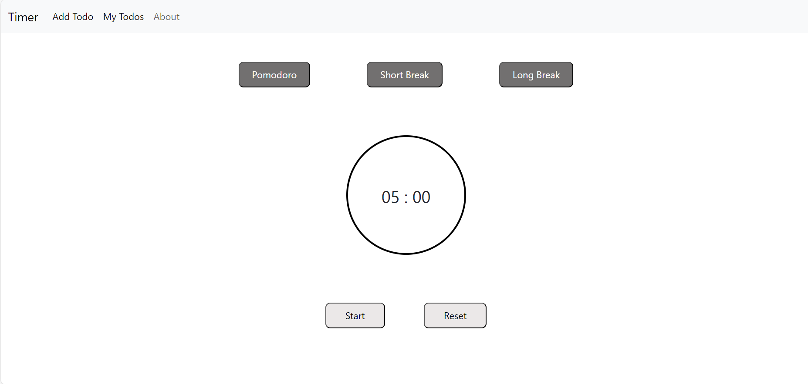
Short Break

Slide 9
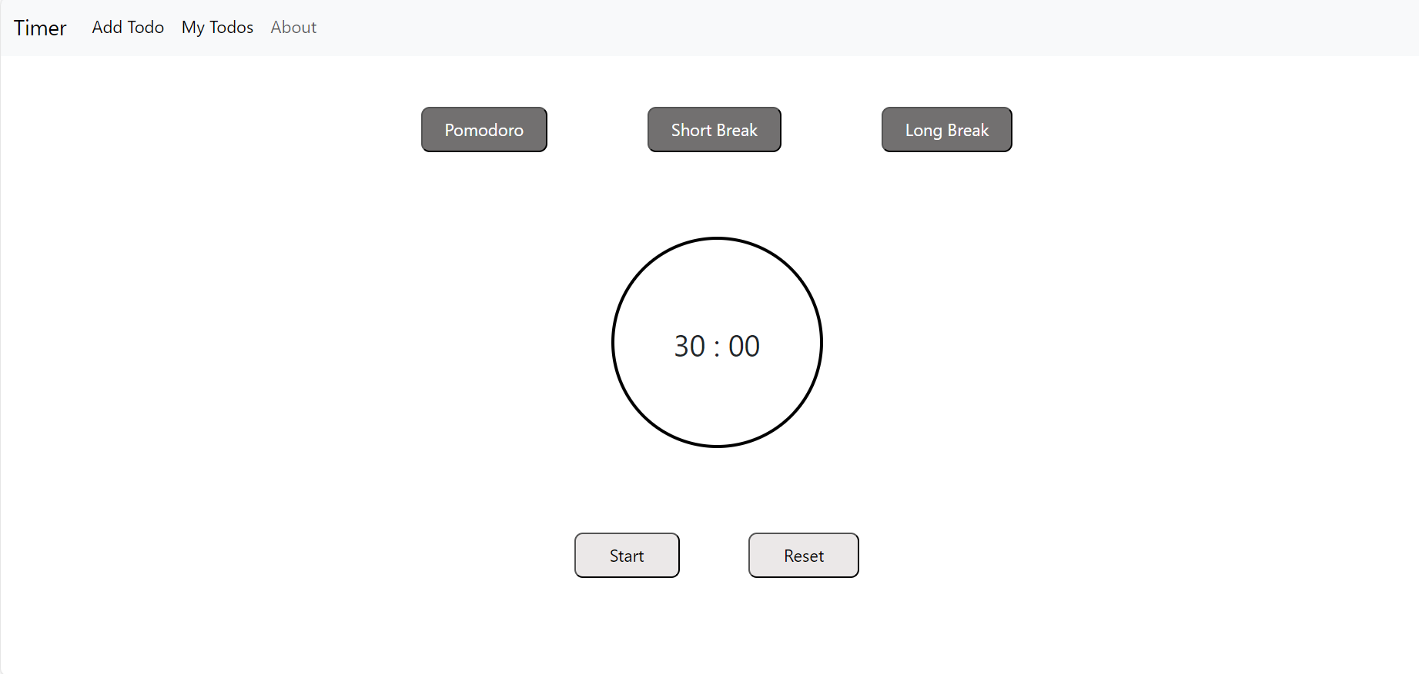
Long Break

Slide 10
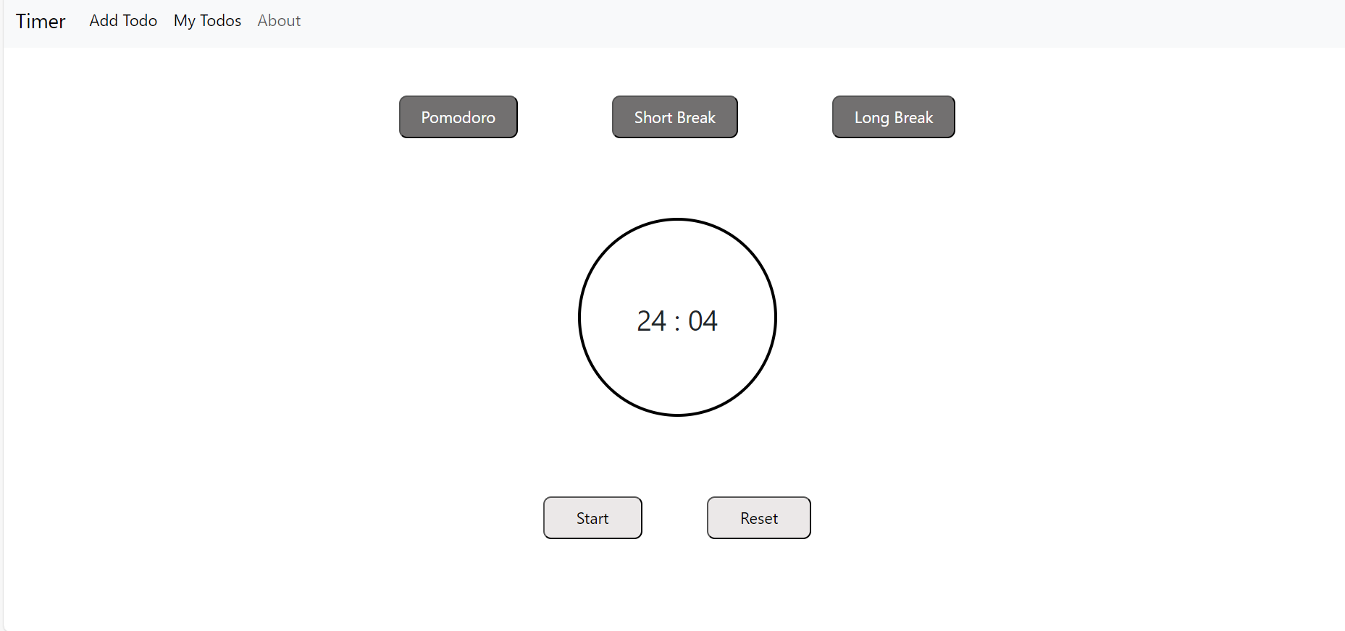
Start button will start the timer and reset button will reset timer to its default value.

Slide 11
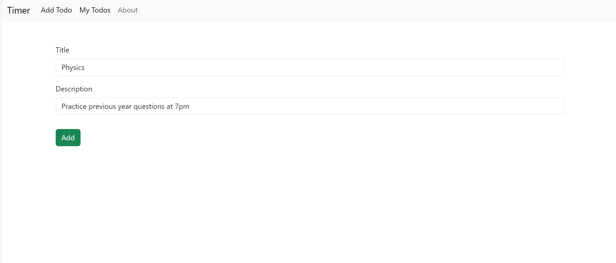
Add Todo

Slide 12
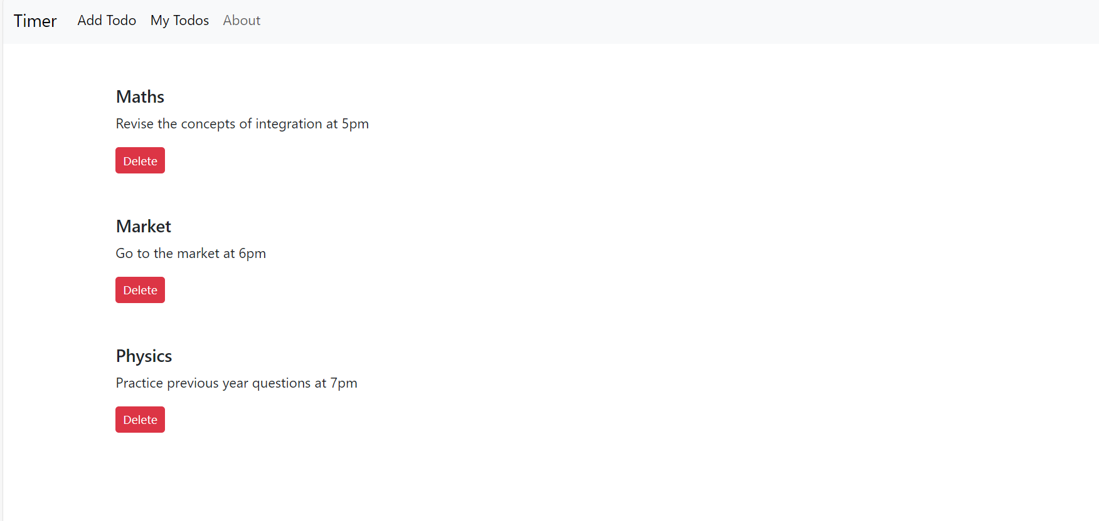
My Todos

Slide 13
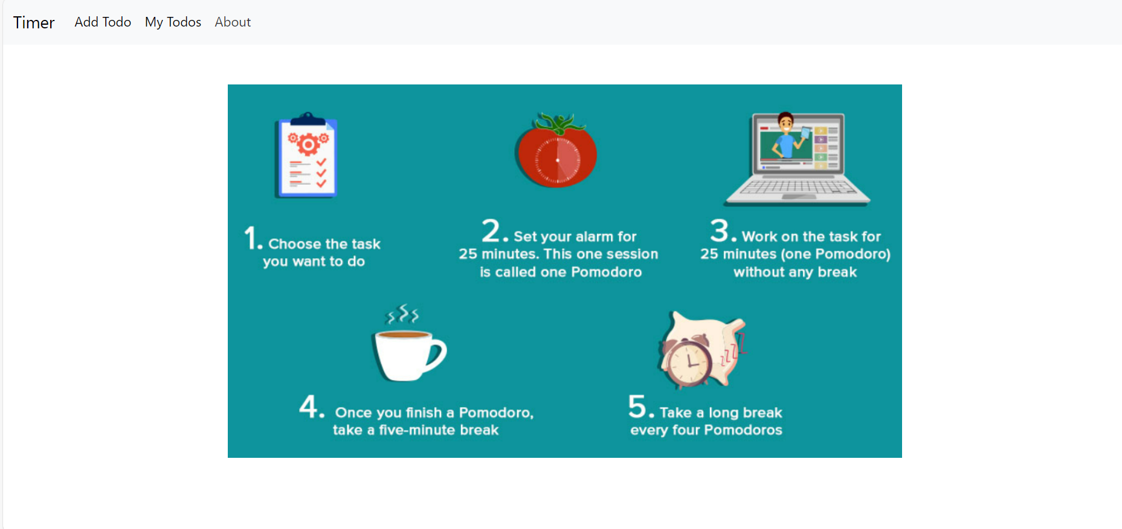
About

Slide 14
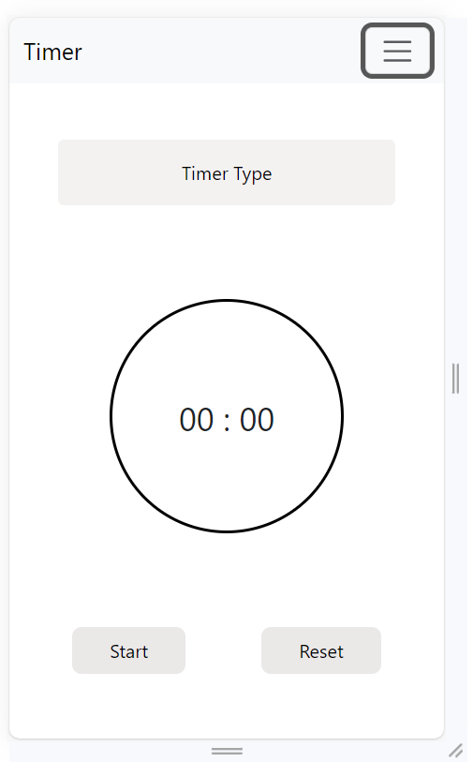
Mobile View

Slide 15
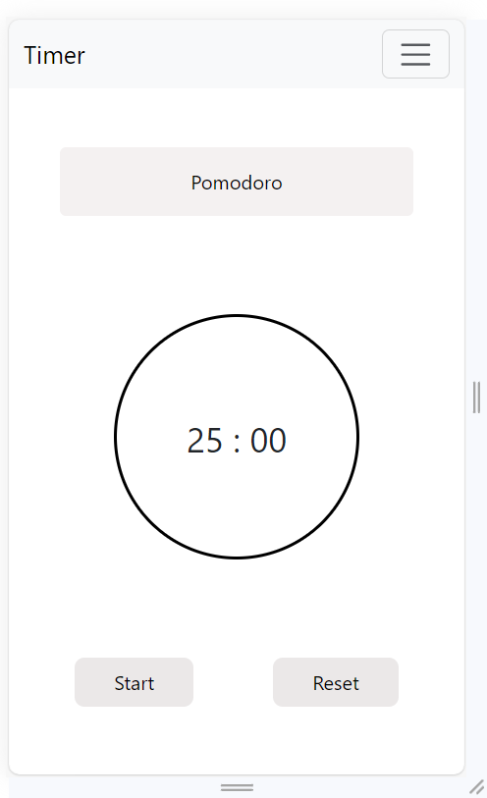
Pomodoro

Slide 16
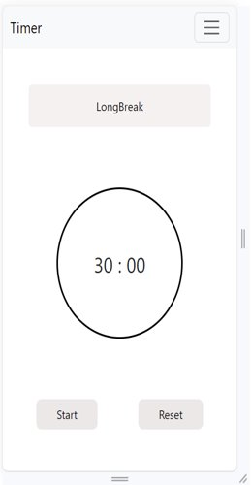
Long Break

Slide 17
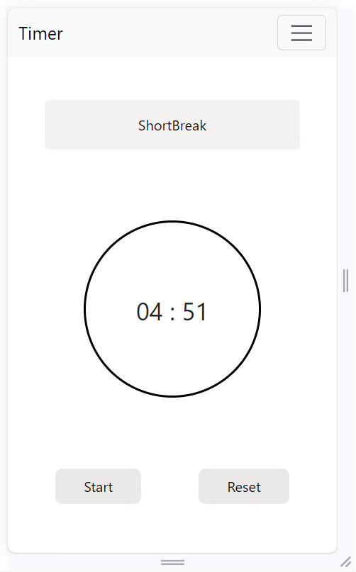
Short Break

Slide 18
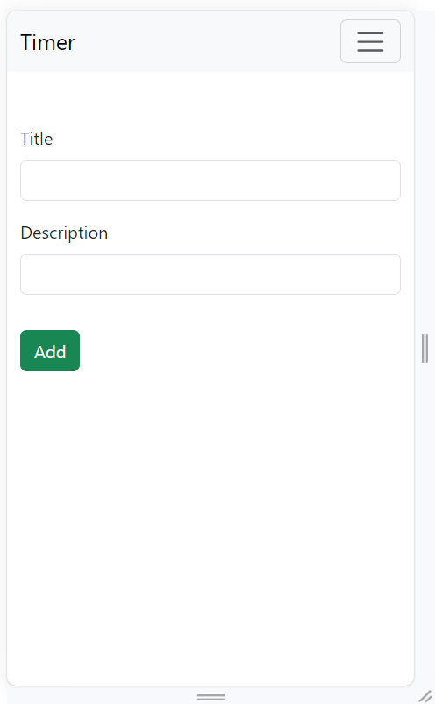
Add Todo

Slide 19
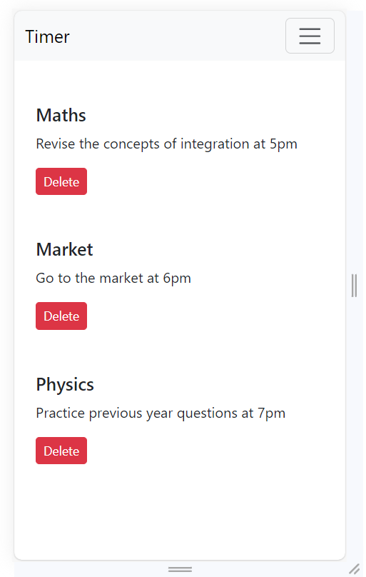
My Todos

Slide 20
The project helped me in learning application development using ReactJS. Various hooks of React are used to implement this application which made the understanding better and also react-router-dom is used to easily navigate from a page to another without any reloading. This is my first application developed using ReactJS and I got a good experience of working with it.

